Slide 1
Genetic Algorithms
Lecture #1
Introduction to Genetic Algorithms

Slide 2
Genetic algorithms are based on the ideas of natural selection and genetics.
They are commonly used to generate high-quality solutions for optimization problems and search problems.
Developed by John Holland in the 1960s, genetic algorithms belong to the broader class of evolutionary algorithms, which mimic the process of natural selection to solve complex problems.
Key Concepts and Terminologies:
Chromosome: A representation of a candidate solution (potential solution to the problem being solved)in the population.
Genes: Components of a chromosome, representing different parameters or features of the solution.
Crossover: A genetic operator that combines genetic material from two parent chromosomes to create offspring (new candidate solutions that are generated from the selected parent solutions).

Slide 3
Mutation: A genetic operator that introduces random changes in offspring, promoting diversity.
Fitness Landscape: The relationship between the fitness of solutions and their positions in the search space.
Convergence: The process where the population evolves towards optimal or near-optimal solutions.
Diversity: The variety of solutions present in the population, essential for maintaining exploration of the search space.

Slide 4
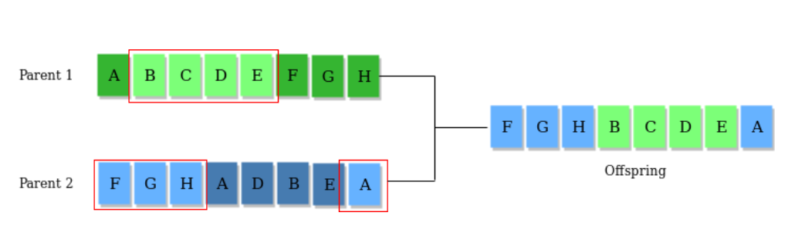
Genetic Operators
Once the initial generation (The process of a genetic algorithm starts by generating the set of individuals, which is called population. Here each individual is the solution for the given problem. An individual contains or is characterized by a set of parameters called Genes. Genes are combined into a string and generate chromosomes, which is the solution to the problem. One of the most popular techniques for initialization is the use of random binary strings)is created, the algorithm evolves the generation using following operators – :
1) Selection Operator: The idea is to give preference to the individuals with good fitness scores and allow them to pass their genes to successive generations.
2) Crossover Operator: This represents mating between individuals. Two individuals are selected using selection operator and crossover sites are chosen randomly. Then the genes at these crossover sites are exchanged thus creating a completely new individual (offspring). For example –

Slide 5
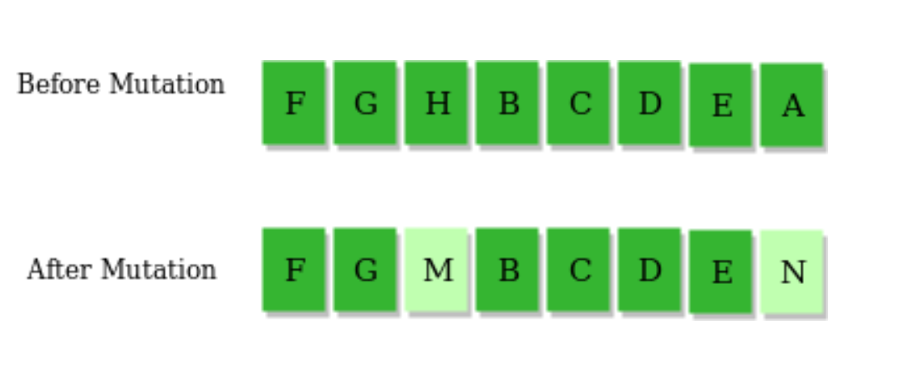
Genetic Operators
3) Mutation Operator: The key idea is to insert random genes in offspring to maintain the diversity in the population to avoid premature convergence. For example –

Slide 6
Working of Genetic Algorithm
Here's a general overview of how genetic algorithms work:
Initialization: The process begins by creating an initial population of potential solutions to the problem. Each solution is typically represented as a string of symbols, called a chromosome or genotype, which encodes a candidate solution. The population is randomly generated or initialized within a predefined search space.
Evaluation: Each individual in the population is evaluated based on a fitness function, which quantifies how well the solution performs with respect to the problem's objectives. The fitness function assigns a numerical value to each individual, indicating its quality or fitness relative to other individuals in the population.

Slide 7
Working of Genetic Algorithm
Selection: Individuals are selected from the current population to serve as parents for the next generation. Selection is typically biased towards individuals with higher fitness values, using mechanisms such as roulette wheel selection, tournament selection, or rank-based selection. The goal is to increase the likelihood of preserving genetic material from high-fitness individuals in the offspring.
Crossover (Recombination): Selected parents undergo crossover or recombination to produce offspring for the next generation. During crossover, genetic material from two parents is combined to create new solutions. This is typically achieved by randomly selecting crossover points along the chromosomes and swapping segments between parents to generate one or more offspring.

Slide 8
Working of Genetic Algorithm
Mutation: Offspring generated through crossover undergo mutation, where random changes are introduced into their genetic material. Mutation helps introduce diversity into the population, preventing premature convergence to suboptimal solutions. It involves randomly altering or flipping certain genes in the chromosome with a low probability.
Replacement: The offspring, along with some portion of the current population (e.g., elites), form the new population for the next generation. Replacement strategies determine how individuals are selected and combined from the parent and offspring populations to form the next generation. Various replacement schemes, such as generational replacement or steady-state replacement, can be employed.
Termination: The algorithm iterates through the selection, crossover, mutation, and replacement steps for multiple generations until a termination criterion is met. Termination conditions may include reaching a maximum number of generations, finding a satisfactory solution, or exceeding a predefined computational budget.

Slide 9
Applications of Genetic Algorithm
Optimization − Genetic Algorithms are most commonly used in optimization problems wherein we have to maximize or minimize a given objective function value under a given set of constraints. The approach to solve Optimization problems has been highlighted throughout the tutorial.
Economics − GAs are also used to characterize various economic models like the cobweb model, game theory equilibrium resolution, asset pricing, etc.
Neural Networks − GAs are also used to train neural networks, particularly recurrent neural networks.
Parallelization − GAs also have very good parallel capabilities, and prove to be very effective means in solving certain problems, and also provide a good area for research.
Image Processing − GAs are used for various digital image processing (DIP) tasks as well like dense pixel matching.

Slide 10
Applications of Genetic Algorithm
Parametric Design of Aircraft − GAs have been used to design aircrafts by varying the parameters and evolving better solutions.
DNA Analysis − GAs have been used to determine the structure of DNA using spectrometric data about the sample.
Multimodal Optimization − GAs are obviously very good approaches for multimodal optimization in which we have to find multiple optimum solutions.
Traveling salesman problem and its applications − GAs have been used to solve the TSP, which is a well-known combinatorial problem using novel crossover and packing strategies.

Slide 11
Genetic Programming
Genetic programming (GP) is an evolutionary computation (EC) technique that automatically solves problems without having to tell the computer explicitly how to do it.
Here's how genetic programming generally works:
Initialization: Initially, a population of random programs (often represented as trees) is generated. These programs are essentially representations of candidate solutions to the given problem.
Evaluation: Each program in the population is evaluated to determine its fitness, which indicates how well it solves the problem. Fitness is typically defined based on a predefined objective or performance metric.
Selection: Programs are selected from the current population to form the next generation. This selection process is often based on the programs' fitness; programs with higher fitness are more likely to be selected.
Crossover: Selected programs are combined (or "crossover") to produce offspring for the next generation. This is analogous to sexual reproduction in biological evolution, where genetic material from two parents is combined to produce offspring.

Slide 12
Genetic Programming
Mutation: Occasionally, random changes (mutations) are introduced into the offspring to maintain diversity in the population and explore new areas of the search space. Mutation helps prevent the algorithm from converging too quickly to suboptimal solutions.
Termination: The process of selection, crossover, and mutation is repeated for multiple generations until a termination condition is met. This condition could be a maximum number of generations, reaching a satisfactory solution, or other criteria specified by the user.
One of the advantages of genetic programming is its ability to automatically discover solutions that might be difficult for humans to find manually. However, it often requires significant computational resources and careful tuning of parameters to achieve good performance on complex problems.

